Slide 1
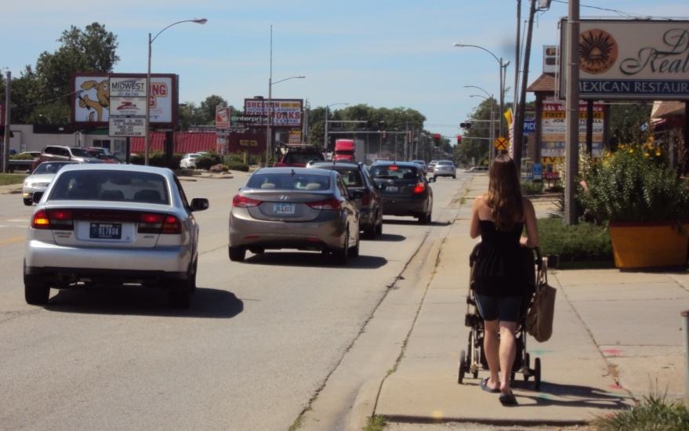
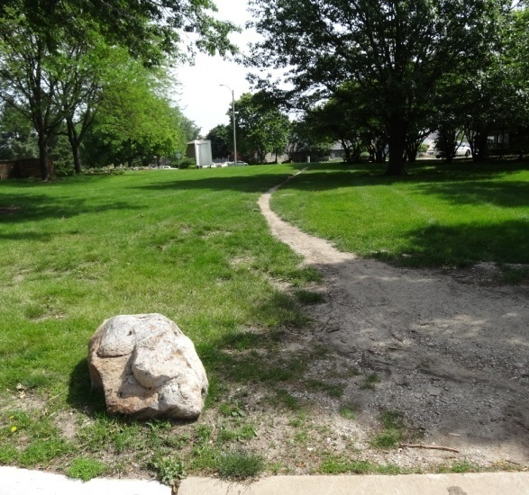
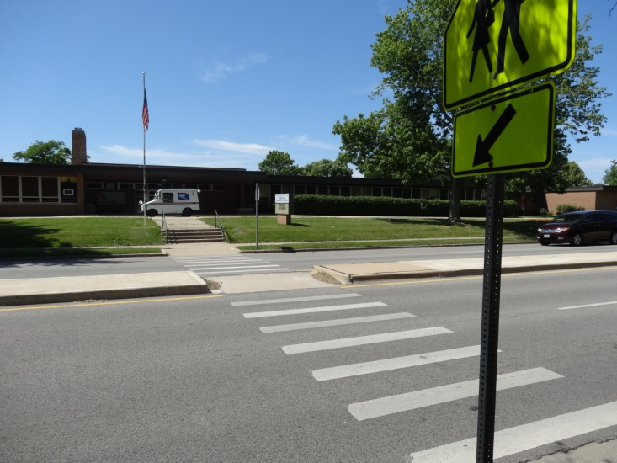
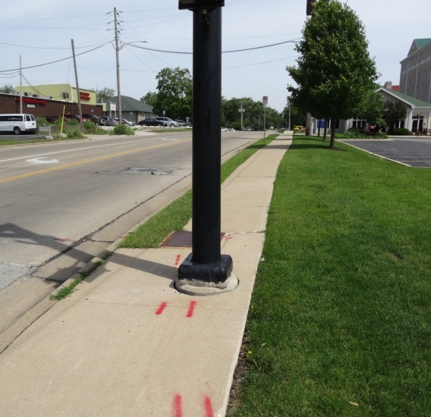
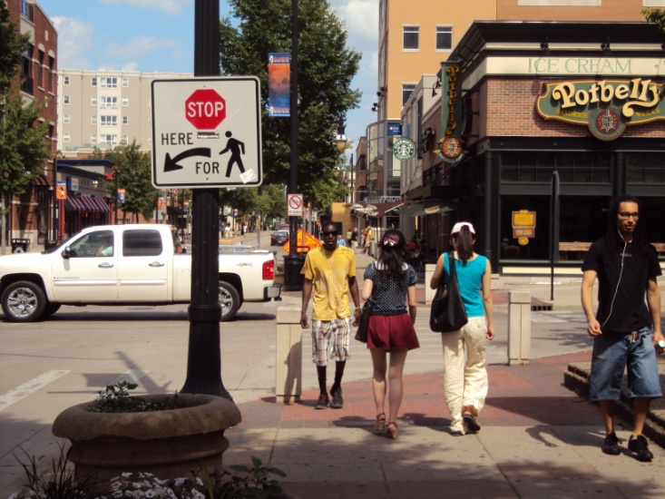
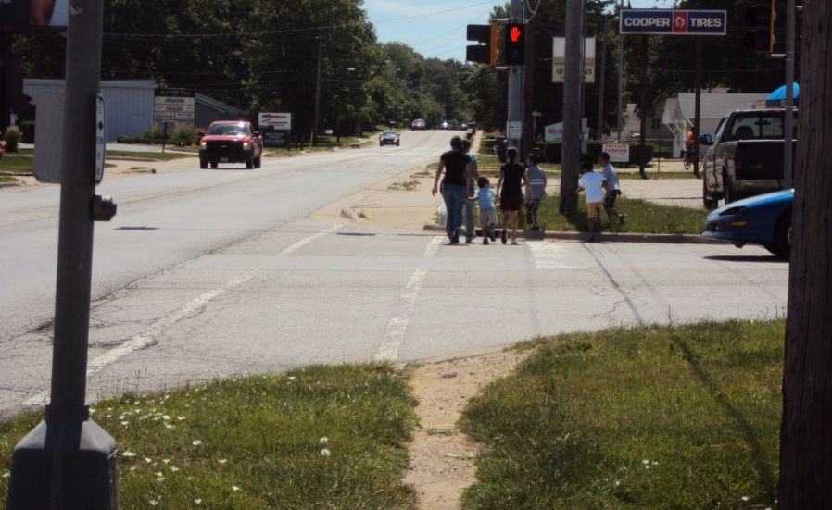
Champaign pedestrian plan
CHAMPAIGN CITY COUNCIL • STUDY SESSION • JULY 9, 2013

Slide 2
Council goals support creating a pedestrian plan
Council Goal 1: “Our City Fosters Quality of Life for All Citizens”
Increase parks, trails, and open space amenities
Council Goal 2: “Our City Provides First-Rate Services”
Aggressively address aging infrastructure
Continue to build complete streets
Support and respond to neighborhood needs
Council Goal 5: “Our City is a Model for Environmental Sustainability”
Promote Champaign as a green community
Encourage the use of alternative modes of transportation
Why develop a Pedestrian Plan?

Slide 3
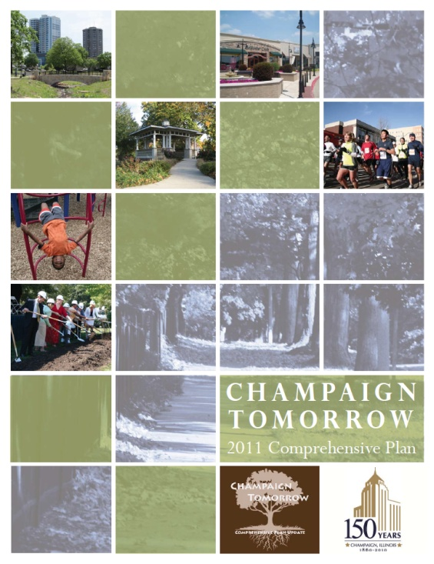
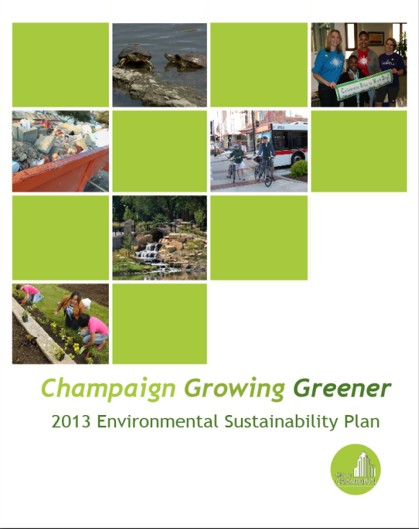
Disconnected pedestrian policies
Implementation Oriented
Vision Oriented
Why develop a Pedestrian Plan?

Slide 4
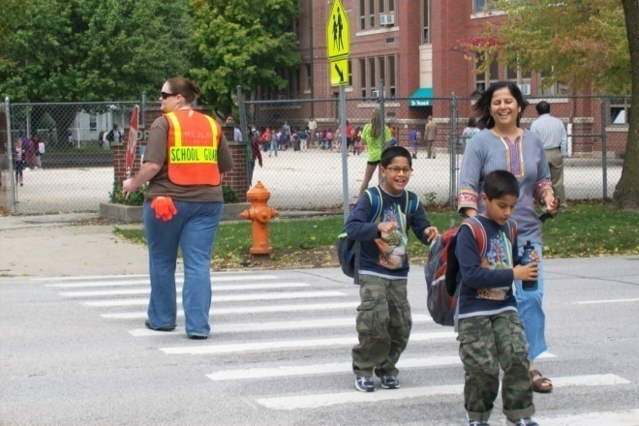
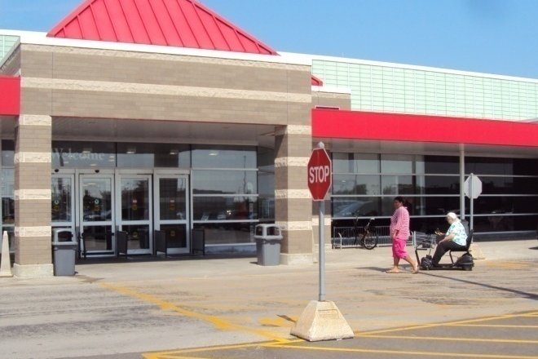
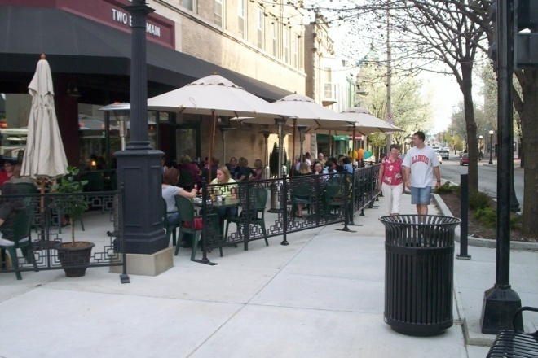
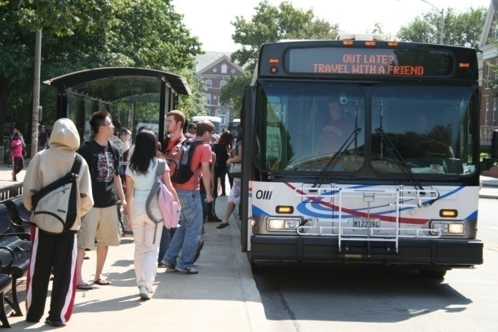
Everyone is a pedestrian every day
Why develop a Pedestrian Plan?

Slide 5
Developing a pedestrian plan
Step 1: Best Practices Research
Determine how other communities plan for pedestrians
Step 2: Existing Conditions Report
Assess Champaign’s pedestrian network at both the citywide scale and the neighborhood scale
Step 3: Issue Identification
Identify issues with pedestrian facilities, street crossings, the connections between destinations, and factors that affect the network’s livability
What are the steps in the planning process?

Slide 6
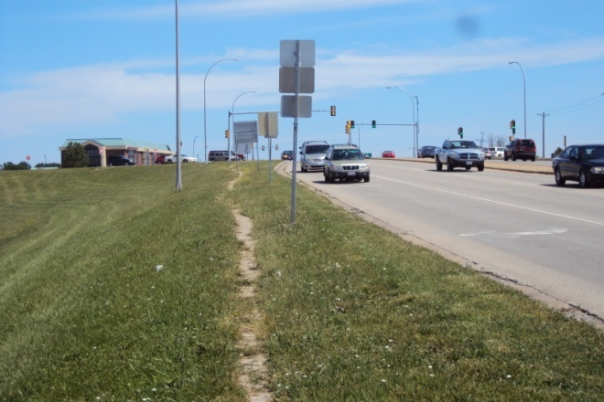
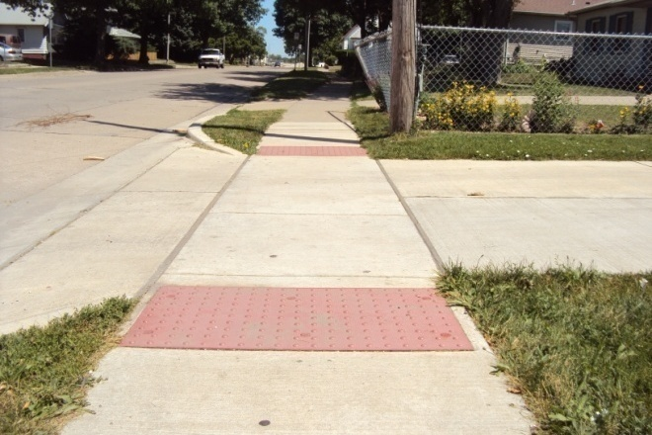
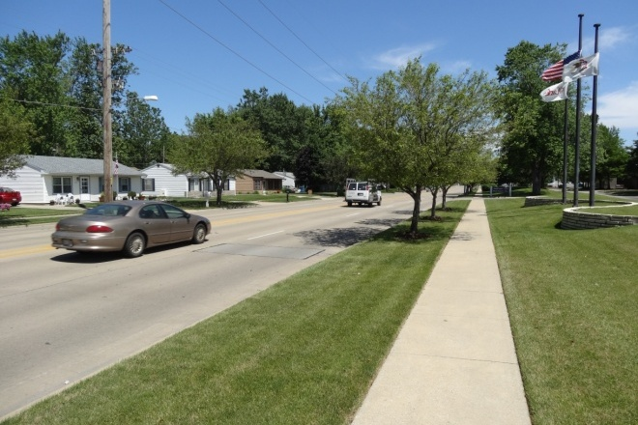
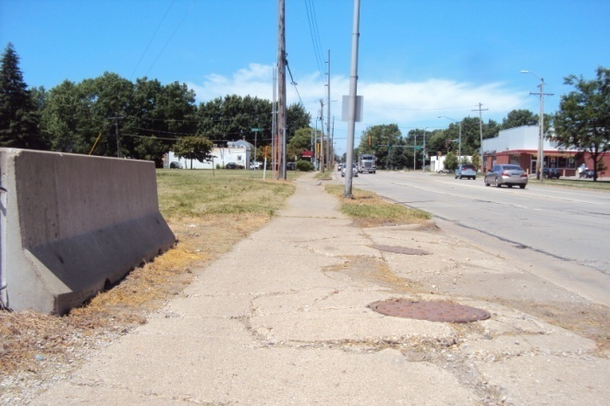
Step 3: issue identification
Facilities
Crossings
Connections
Livability
What are the steps in the planning process?

Slide 7
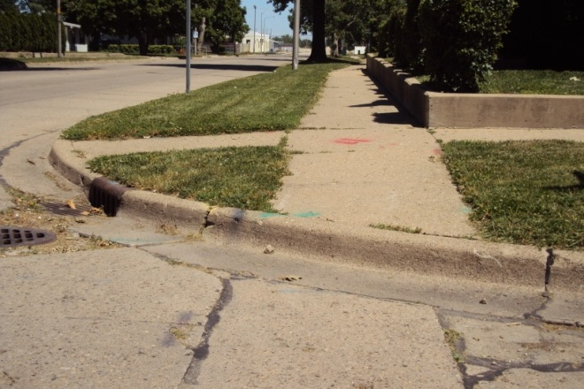
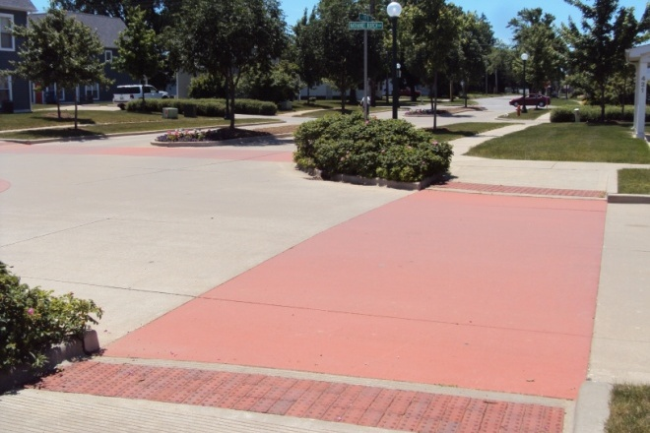
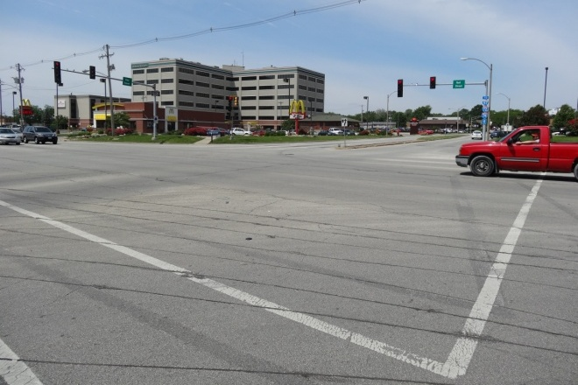
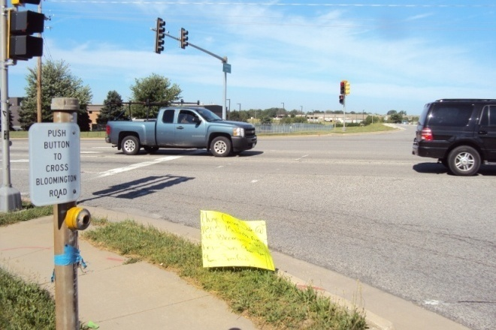
Step 3: issue identification
Facilities
Crossings
Connections
Livability
What are the steps in the planning process?

Slide 8
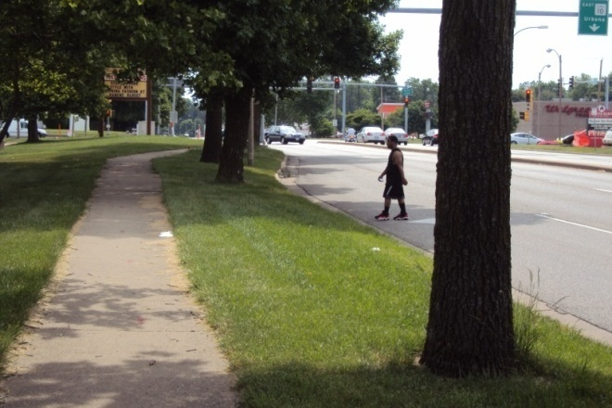
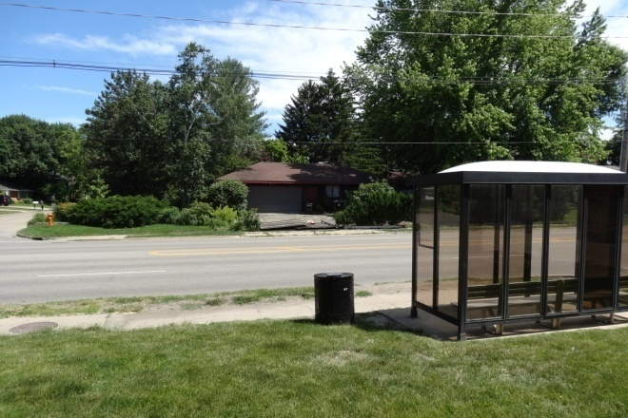
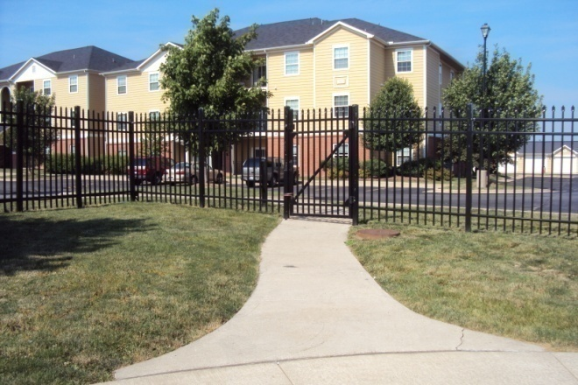
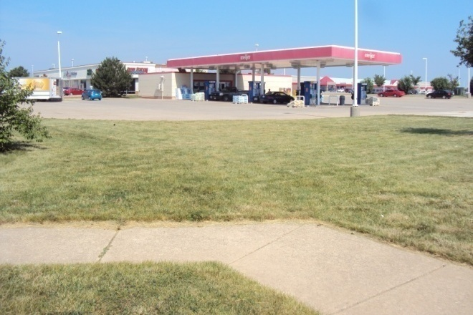
Step 3: issue identification
Facilities
Crossings
Connections
Livability
What are the steps in the planning process?

Slide 9
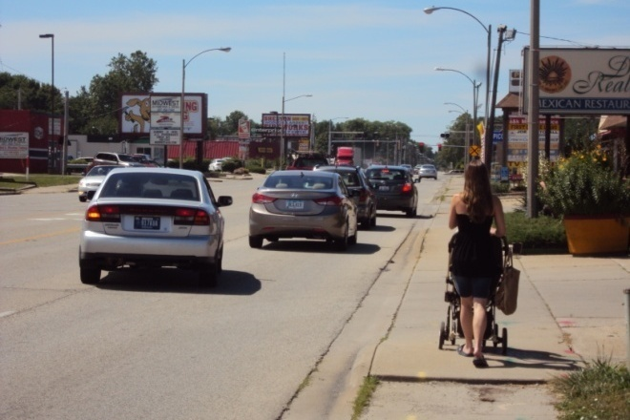
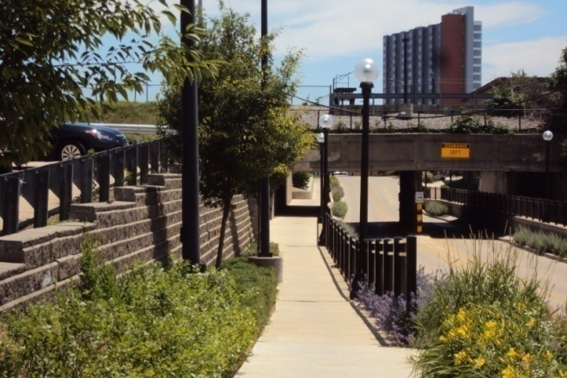
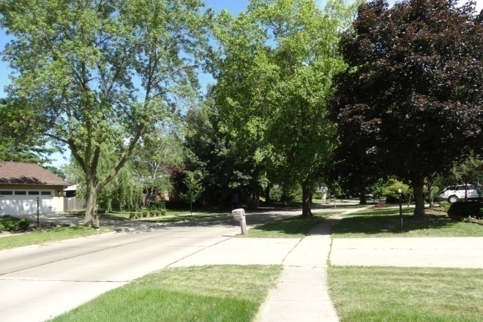
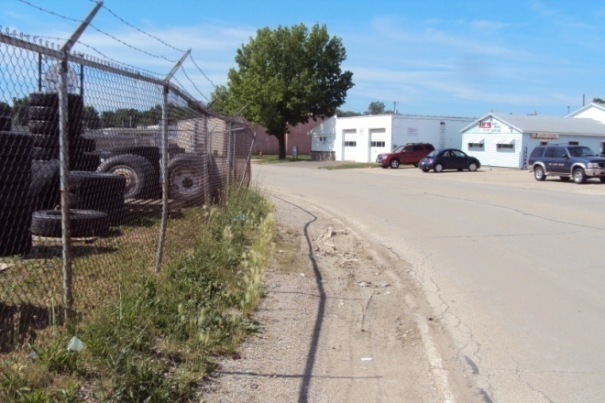
Step 3: issue identification
Facilities
Crossings
Connections
Livability
What are the steps in the planning process?

Slide 10
Developing a pedestrian plan
Step 1: Best Practices Research
Determine how other communities plan for pedestrians
Step 2: Existing Conditions Report
Assess Champaign’s pedestrian network at both the citywide scale and the neighborhood scale
Step 3: Issue Identification
Identify issues with pedestrian facilities, street crossings, the connections between destinations, and factors that affect the network’s livability
Step 4: Strategy Development
Create a method for prioritizing pedestrian projects and policies
What are the steps in the planning process?

Slide 11
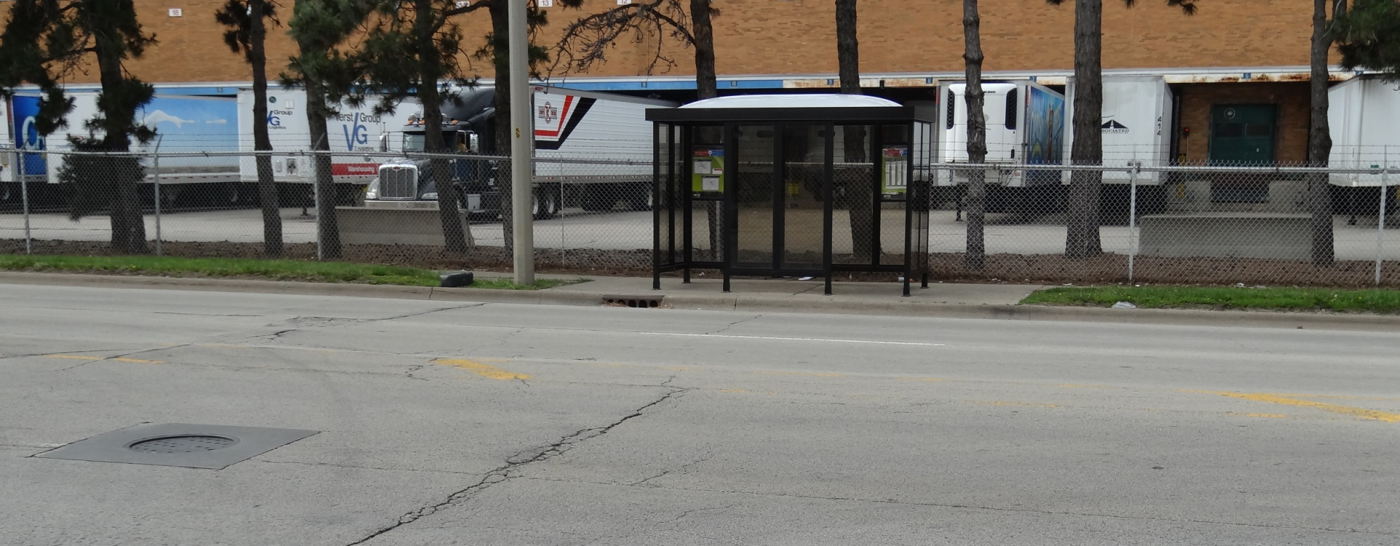
Pedestrian plan benefits
Streets will be easier to cross
Walking between destinations will be easier
Improved “transit-assisted walking”
Supports many recent plans
Pairs implementation with vision
Most importantly…
Pedestrian network will be more accommodating for all
What are the intended outcomes of the Plan?

Slide 12
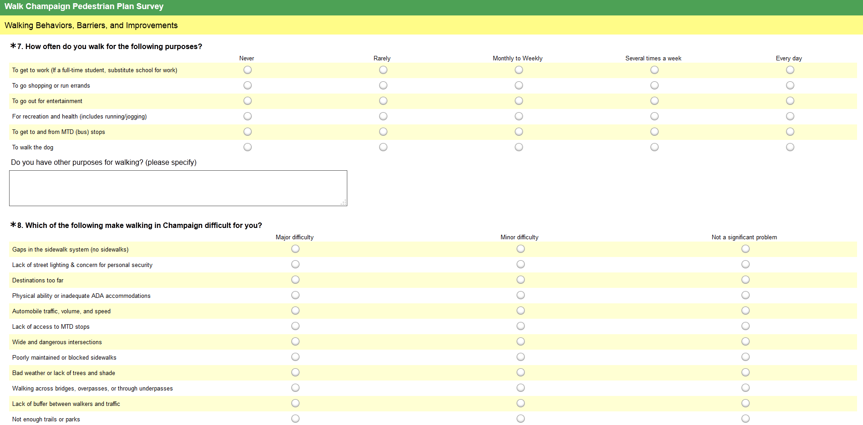
Community survey
Available at http://www.surveymonkey.com/s/walkchampaign
What are the opportunities for public involvement?

Slide 13
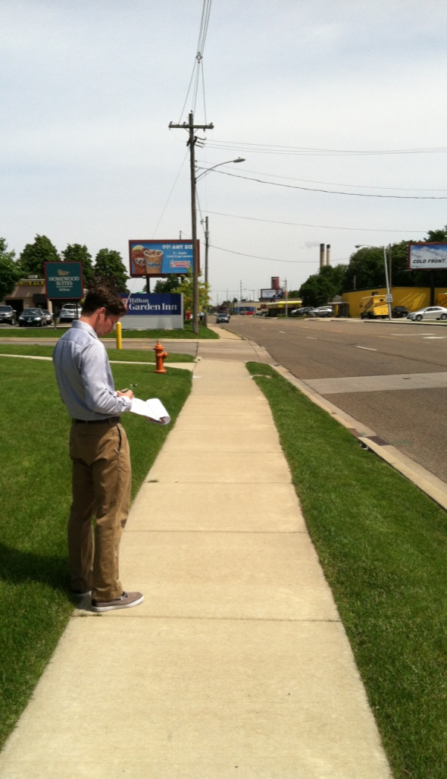
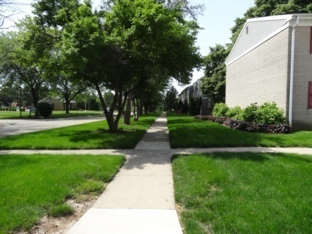
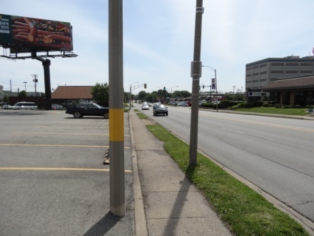
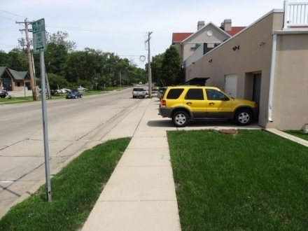
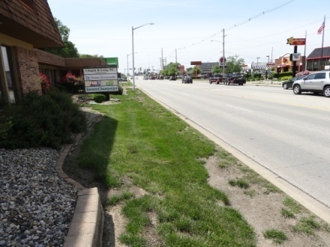
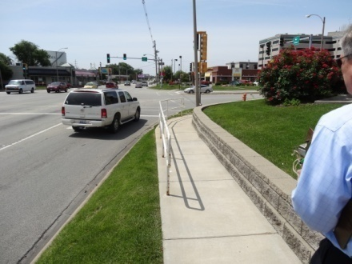
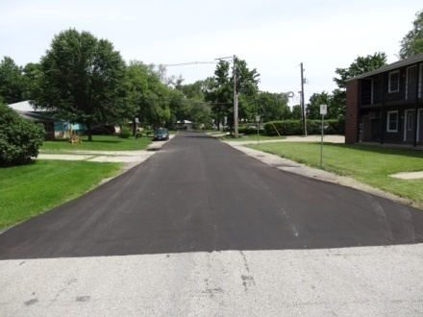
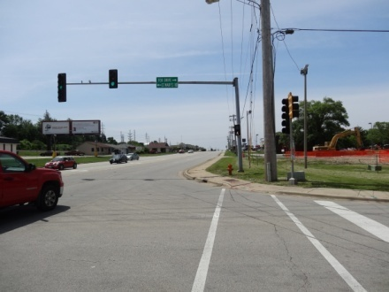
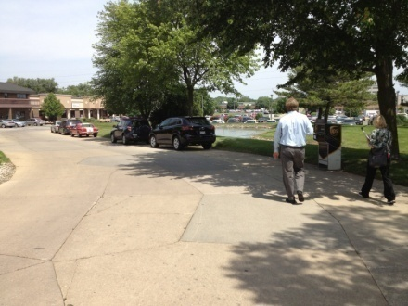
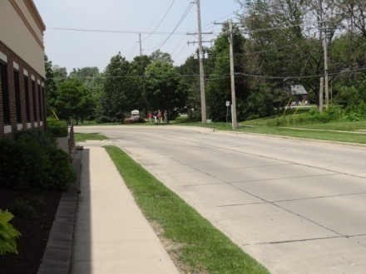
Neighborhood walkabouts
What are the opportunities for public involvement?

Slide 14
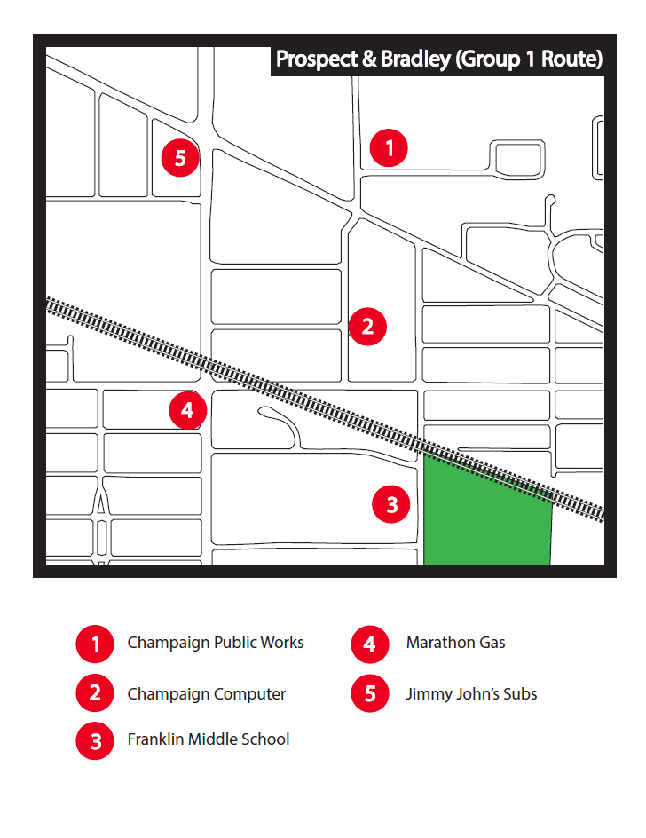
Neighborhood walkabouts
10-15 participants in each session
Participants will walk the route
groups of 2-4
Participants a mixture of city staff, neighborhood residents, and members of interested groups
(e.g. C-U Public Health District)
Sessions will last approximately
2 hours
What are the opportunities for public involvement?

Slide 15
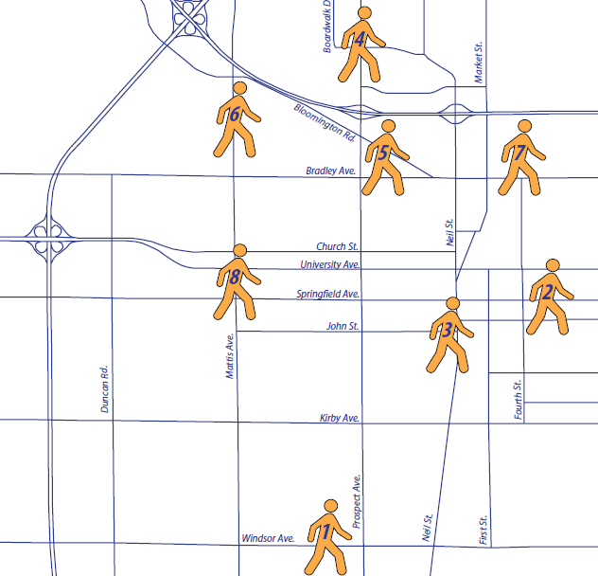
Neighborhood walkabouts
1) Windsor and Galen
July 16
2) Campustown
July 18
3) South Downtown
July 23
4) North Prospect
Aug 1
5) Prospect and Bradley
Aug 6
6) Garden Hills
Aug 8
7) Douglass Park
Aug 15
8) Country Fair
Aug 20
What are the opportunities for public involvement?

Slide 16
Pedestrian
Plan
Website
www.ci.champaign.il.us/walk
What are the opportunities for public involvement?

Slide 17
Pedestrian plan timeline
2013
2014
June
July
Aug
Sept
Oct
Nov
Dec
Jan
Feb
Mar
Apr
May
Issue Identification
Discussions with partner agencies
Strategy Development
Drafting of plan; presentation to Plan Commission and City Council
Existing Conditions Report
(Walkabouts complete by end of August)
When will the Pedestrian Plan be ready?

